Slide 1
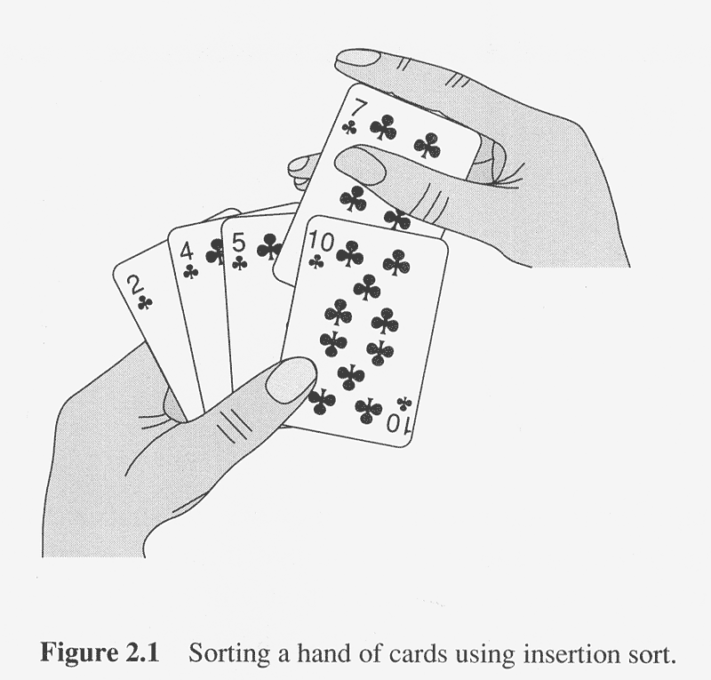
Insertion Sort with Cards

Slide 2
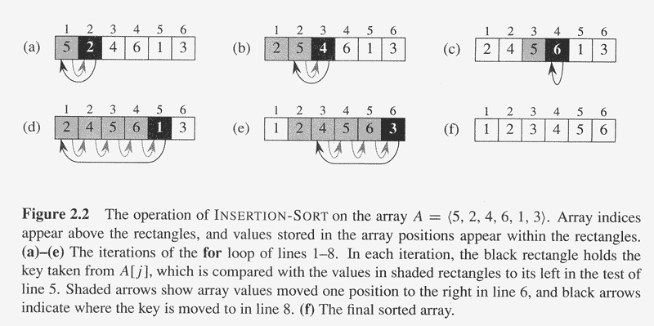
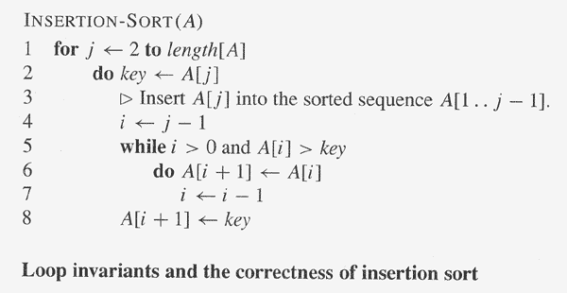

Slide 3
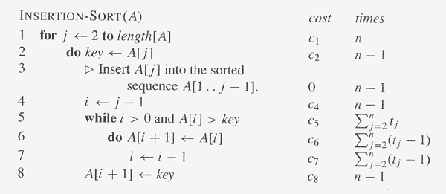
Why?
t_{j} is the number of times the while loop test in line 5 is executed
for that value of j.
T(n) = c₁n + c₂(n-1) + c₄(n-1) + c₅ ∑_{j=2..n} t_{j} + c₆ ∑_{j=2..n} (t_{j}-1)
+ c₇ ∑_{j=2..n} (t_{j}-1) + c₈(n-1)
Ques: What are the best and worst-case running times of
INSERTION-SORT?
How about average-case?

Slide 4
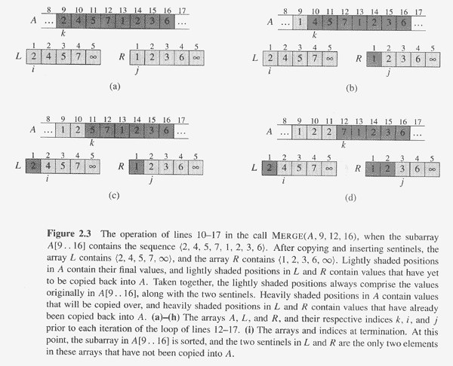
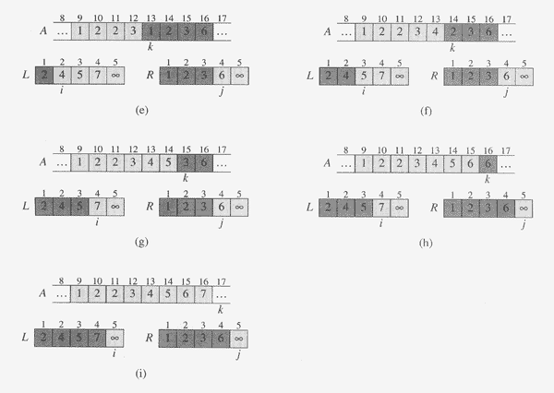
MERGE
MERGE(A, p, q, r) merges subarrays A[p..q] and A[q+1..r],
assuming that they are each already sorted.

Slide 5
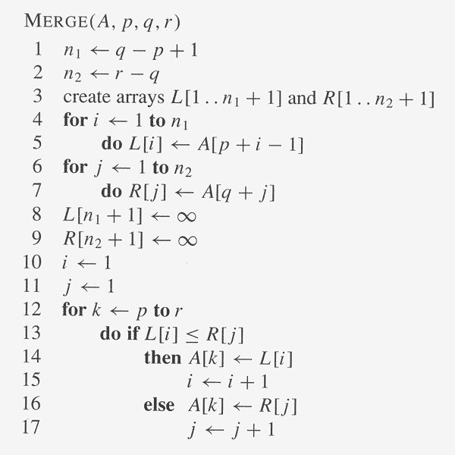
MERGE() requires extra space
– arrays L and R – of the size
of the input + 2.
Ques: What is the time
complexity of MERGE? (Linear)
Ques: Could the merging be
done in-place ? I.e., just using
the input space (plus maybe a
constant amount of extra space).
E.g., like INSERTION-SORT.
What is the run time of your
algorithm?
Ques: Ok, how about in-place
and in linear time?!

Slide 6
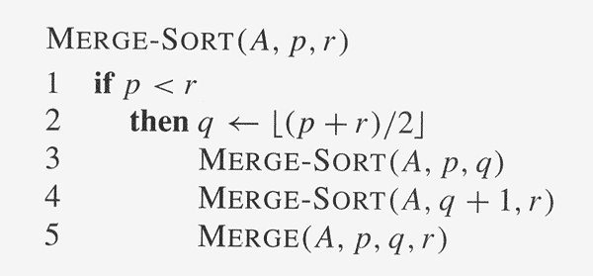
Divide-and-Conquer: MERGE-SORT
Label1:
Labe12:
Label3:

Slide 7
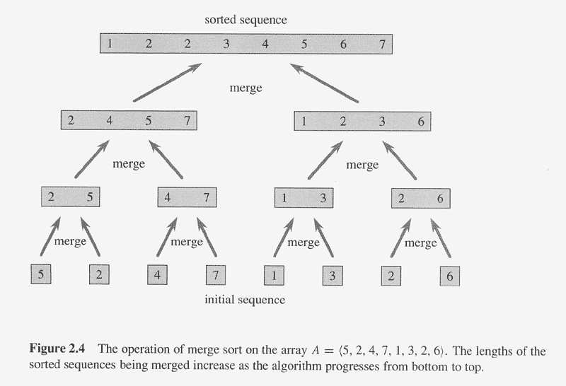
Merge Sort, Pictorially

Slide 8
Calculating the Factorial: Use of the Stack in Recursion
Consider computing the factorial recursively:
int Fact(int n)
{ if (n < 1) return 1;
Label1: else return n*Fact(n-1);
}
How is the stack used?
For a MIPS assembly language implementation of this routine see factorialRecursive.asm in http://www.cs.ait.ac.th/~guha/COA/Spim/ -> Examples Very useful !! Shows how recursion is actually implemented during run-time!
What is the run time of Fact()?
Can recursion be avoided? Replaced with iteration ? What’s the advantage/disadvantage?
How is the stack used in MERGE-SORT ?

